Slide 1

CHATBUDYY
Chat Bot Using Neo4j
Team Members
Arslan Jamil - Fa20-bse-002
Labia Qaiser -Fa20-bse-006
Muhammad Mehroz - Fa20-bse-071

Slide 2
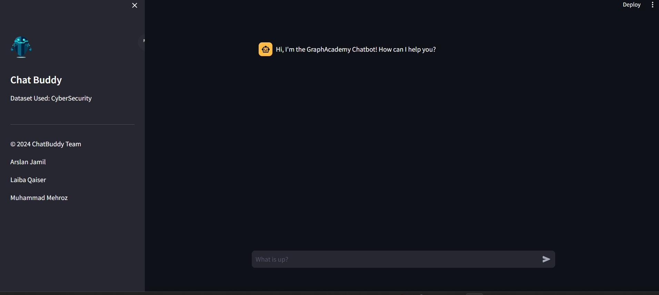
Chat Buddy UI

Slide 3
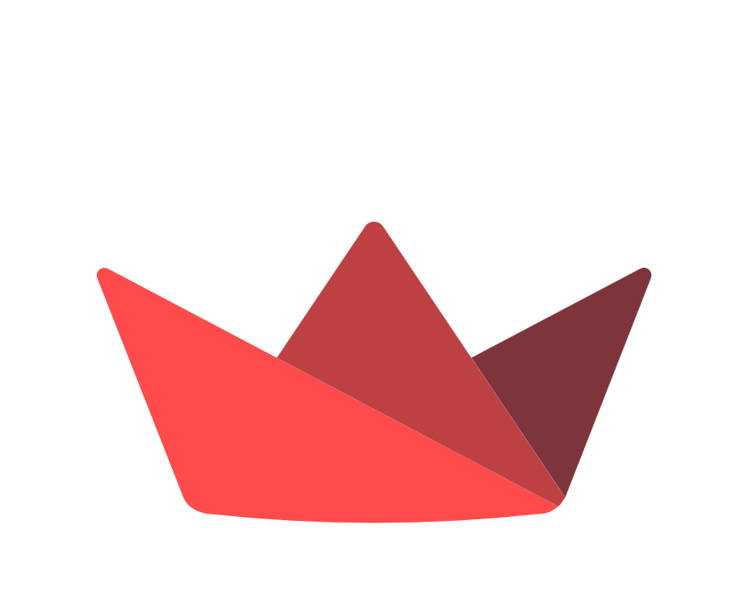


Technologies
Stream Lit
OpenAI
Neo4j
Transforming Python scripts into interactive web apps with ease
OpenAI has gained prominence through its Generative Pretrained Transformer (GPT) series. GPT models are trained on vast datasets to generate text that mimics human writing.
Neo4j organizes data in a graph structure comprised of nodes, relationships, and properties. This allows for flexible and efficient representation of complex relationships and interconnected data.

Slide 4

Project Setup
Installing Python locally
Cloning the git repository
Install the project dependencies stream lit, Lang chain, OpenAI and neo4j driver
Command to run the project

Slide 5
Creating llm instance
Configuring the LLM instance to communicate with a GPT model using OpenAI.
There are the following steps for achieving this: 1-Obtain an API key
2-Setting Streamlit Secrets
Create a secrets.toml file in .streamlit/ folder.
Add the text and the api key in the .streamlit/secrets.toml file .
Access the values in the streamlit file using the command st.secrets map
Initializing the open Ai
Create a new llm.py file in the project root. Create a new variable called llm assigned to a new instance of the ChatOpenAI class.
The LLM should be initialized with an openai_api_key keyword argument.

Slide 6
Initializing the embedded model
Create an instance of the OpenAI Embeddings model. This will be used by Lang chain to create an embedding of the user’s input which will be used to find similar documents using Neo4j’s vector index.

Slide 7
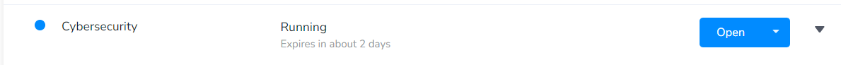
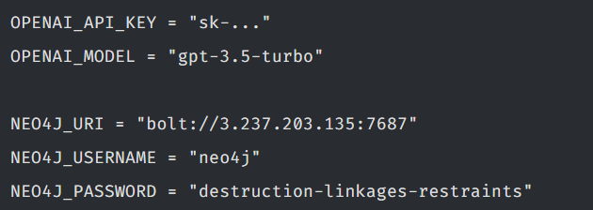
Connecting with Neo4j
You will need to create an instance of the Neo4jGraph class that is configured to connect to the Neo4j Sandbox instance was created for you when you enrolled in the course.
Set these as secrets in the Streamlit app by opening the .streamlit/secrets.toml and paste the following values.

Slide 8
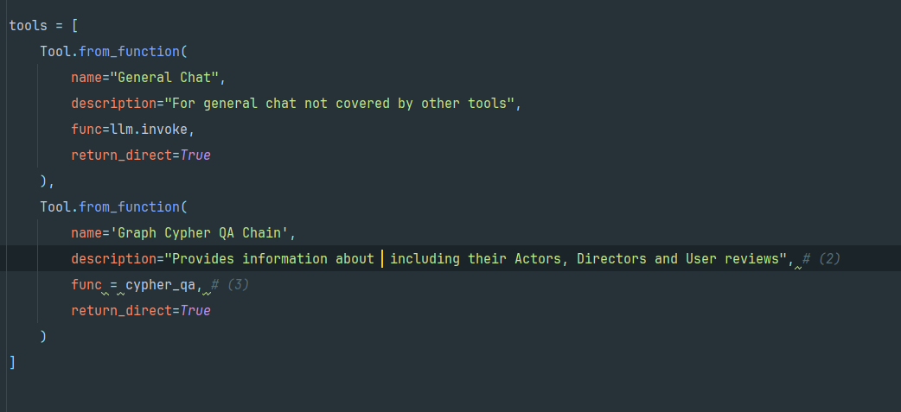
Creating the agent
Agents are run using an AgentExecutor object, which is responsible for executing the actions returned by the Agent.

Slide 9
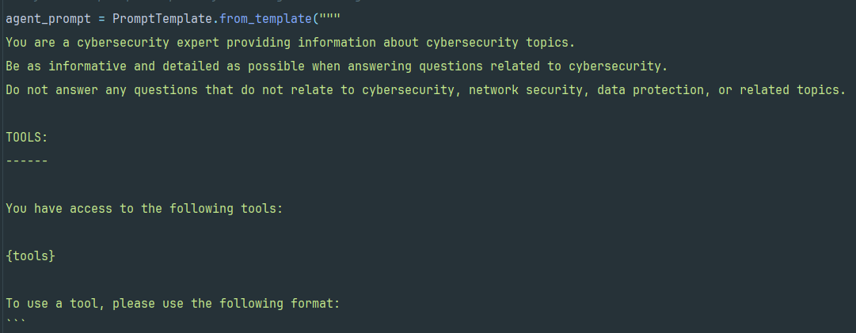
Defining the scope
To avoid end-users misusing the agent, the scope of the agent can be restricted in the form of a System Prompt.
We used the Langchain hub to download the hwchase17/react-chat prompt for ReAct Agents.
Making own Scope
Writing an custome Prompt Template specific for our chat bot which is trained on the specific data .

Slide 10
Graph semantic search vs Vector search
Graph Search | Vector Search
Graph Representation: In addition to vector representations, data entities (such as movies, actors, directors, etc.) are also represented as nodes in a graph. Relationships between these entities are represented as edges in the graph. | Lack of Precision: Vector similarity doesn't always guarantee precise matches. It may group together items that are somewhat related but not exactly what the user is looking for. For example, in a movie recommendation system, it might suggest movies with similar themes or genres but not necessarily with identical plots or characters.
Contextual Insights: By leveraging the graph structure, the search algorithm can consider the relationships and hierarchies between entities. For instance, in a movie graph, relationships could represent actor-director collaborations, sequels, genres, and more. | Limited Contextual Understanding: Vector representations focus primarily on the statistical relationships between words or features within documents. While this captures some semantic meaning, it may miss out on deeper contextual understanding or nuances present in the data.

Slide 11
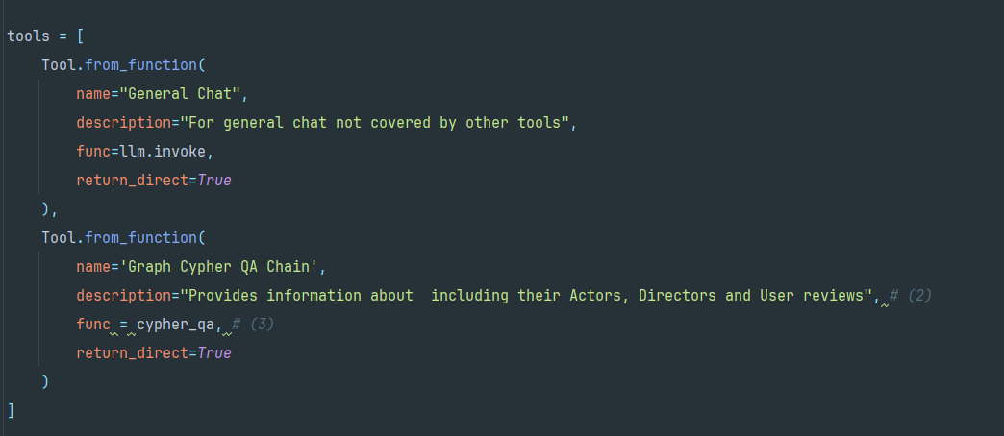
Steps to Implement Graph Search
Create a Graph Cypher QA Chain
Register the Chain as a Tool

Slide 12
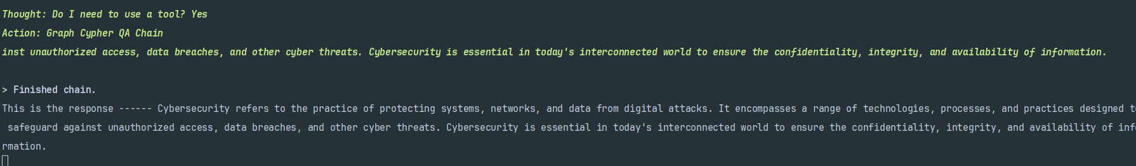

Results
After using Graph Search the results are contextual and precise according to data we have used.

Slide 13


